Slide 1
Deploying Egeria
Mandy Chessell, IBM

Slide 2
Egeria - open metadata and governance distributed platform
Governance tools
Analytics and AI Tools
BI Tools
Open Metadata and Governance
ETL and Data Movement Engines
Security Tools
Data Platforms
Dev and DevOps Tools
Virtualization Platform
Notes:
If they should have, take steps to add " + "them to the authorized list of users. If this user should not have access, investigate where the request " + "came from to determine if the system is under attack, or it was a mistake.

Slide 3
A hybrid multi-cloud world
Independent metadata Repository
New applications deployed to cloud
Mobile Apps
IoT devices and
systems
Business Partners
Sharing data
Linked metadata Repositories
Data Lake
Applications
Databases
Files
Applications

Slide 4
Open metadata ecosystem
Independent metadata Repository
New applications deployed to cloud
Mobile Apps
IoT devices and
systems
Business Partners
Sharing data
Linked metadata Repositories
Data Lake
Applications
Databases
Files
Applications

Slide 5
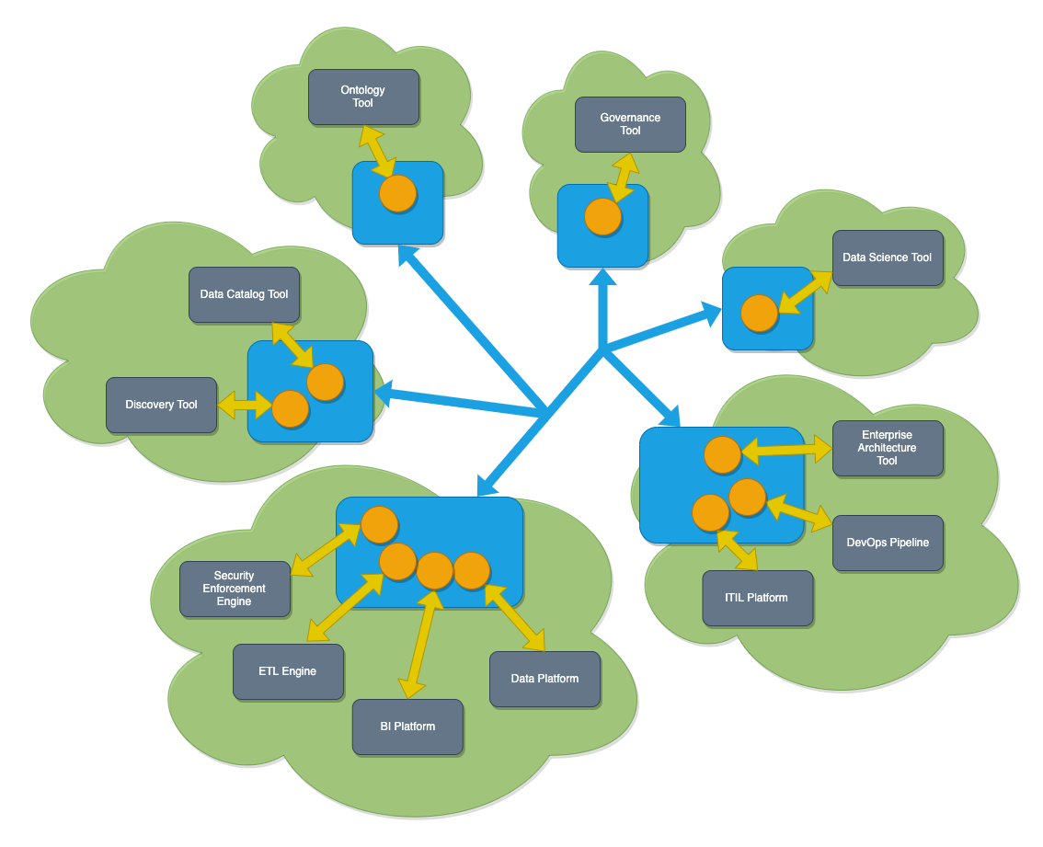
Egeria in operation
Egeria’s platform (in blue) runs in each deployment environment (cloud or on premises)
Egeria servers (orange circles) are deployed on the platform. Each are specialized to support the metadata needs of specific technologies
Egeria manages the exchange of metadata between all parties.

Slide 6
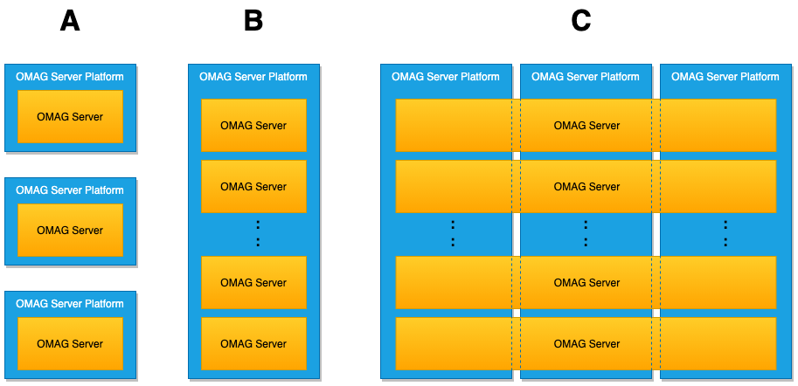
The OMAG Server Platform
Edge
Multi-tenant
Horizontal Scale-out

Slide 7
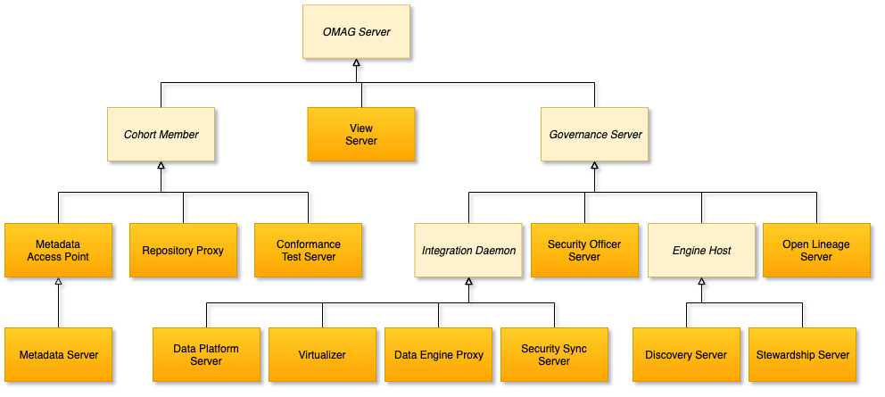
Types of OMAG Servers
** Repository Proxy IS A Cohort Member**
** Cohort Member IS A OMAG Server **

Slide 8
Types of OMAG Servers – OMAG Server

Slide 9
Common Services for OMAG Servers
Manage configuration
Deploy configuration to a different platform
Start/Stop on a platform
Query running configuration
Query Active and Known Servers
Query Active Subsystems in a specific server
Query descriptions of specific types of OMAG Subsystems
More Later …

Slide 10
Types of OMAG Servers – Cohort Members

Slide 11
Example of a simple cohort
Data Lake
Cohort A
Chief Data Office
Systems of Record

Slide 12
Connecting to multiple cohorts
Data Lake
Marketing
Data Lake
Cohort A
Cohort B
Chief Data Office
Systems of Record
Systems of Record
Mobile
Apps

Slide 13
Types of OMAG Servers – Metadata Access Points

Slide 14
Minimising integration costs
Use cases,
Personas,
Practitioners
input
Search
Open Metadata Access Services
Open Metadata Repository Services
Data integration, availability and integrity best practices
Notes:
The internal architecture of Egeria has two distinct layers.
The Open Metadata Access Services layer supports the different types of user and use case.
The Open Metadata Repository Services layer provides the unified view of metadata across distinct systems, using protocols and repositories for access and exchange of metadata objects.
Egeria’s OMRS layer includes the ability to refer to remote objects or replicate cached copies of remote objects for performance and availability
Egeria can store this distributed model in its own local repositories, which support the storing of:
local objects,
replicas of remote objects and
proxy-references to remote objects.

Slide 15
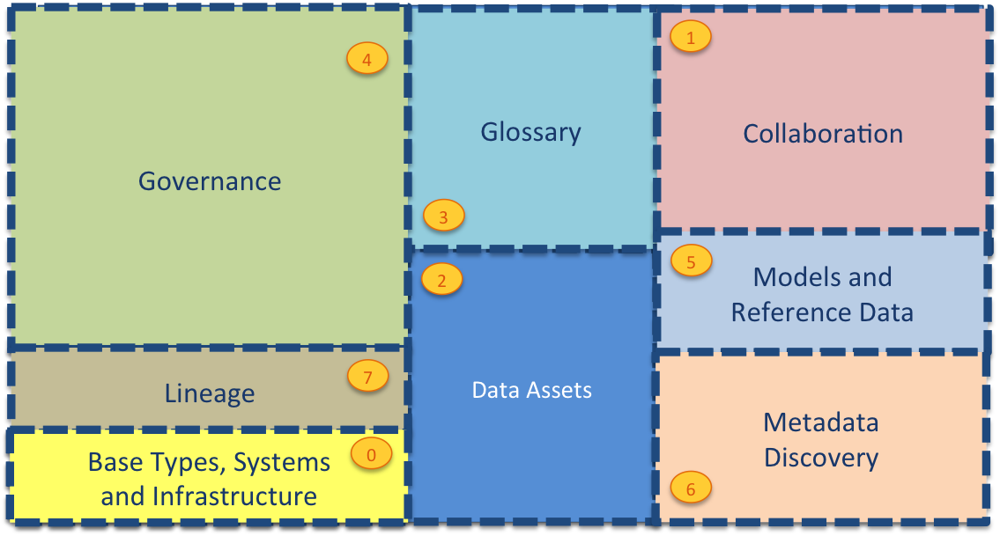
Current Open Metadata Access Services (OMASs)
Asset Consumer
Asset Owner
Asset Lineage
Subject Area
Asset Catalog
Community Profile
Stewardship Action
Project Management
Information View
Data Science
Governance Program
Software Developer
Data Privacy
Digital Architecture
Data Process
Data Protection
DevOps
Governance Engine
Data Infrastructure
Data Platform
Connected Asset
Discovery Engine

Slide 16
Types of OMAG Servers – Metadata Servers

Slide 17
Importance of the distributed graph model
Database
Column
Glossary Term
Server 1
Server 2
Entity
Entity

Slide 18
Importance of the distributed graph model
Database
Column
Glossary Term
Glossary
Term
Meaning
Server 1
Server 2
Reference
Copy
Relationship

Slide 19
Importance of the distributed graph model
Database
Column
Glossary
Term
Server 1
Server 2
Database Column
Glossary
Term
Meaning
Server 3
Egeria Metadata Server

Slide 20
Types of OMAG Servers – Governance Servers

Slide 21
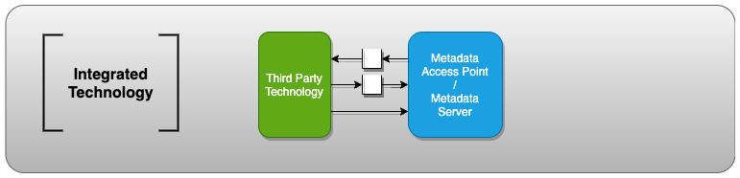
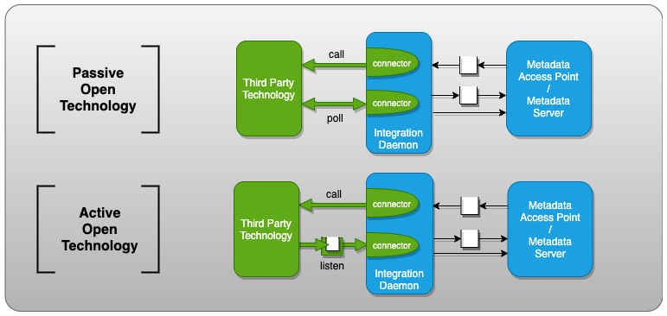
Integration patterns
Egeria supports different styles of integration since there is a huge variety in the capabilities of third-party technologies.

Slide 22

Capturing data sources examples
Data Platform
Server
Metadata
Server
RDBMS
Data Platform OMAS
Poll
Apache Cassandra
Listen
Asset Owner OMAS
Avro Files

Slide 23
A potential deployment of Egeria
Data Virtualization
Virtualizer
Data Lake
Chief Data Office
Metadata Server
Apache Ranger
Security-Sync
Cohort A
Metadata Server
Stewardship
Proxy
Data Platform
Systems of Record
Metadata
Server
Discovery
Stewardship
Data Onboarding

Slide 24
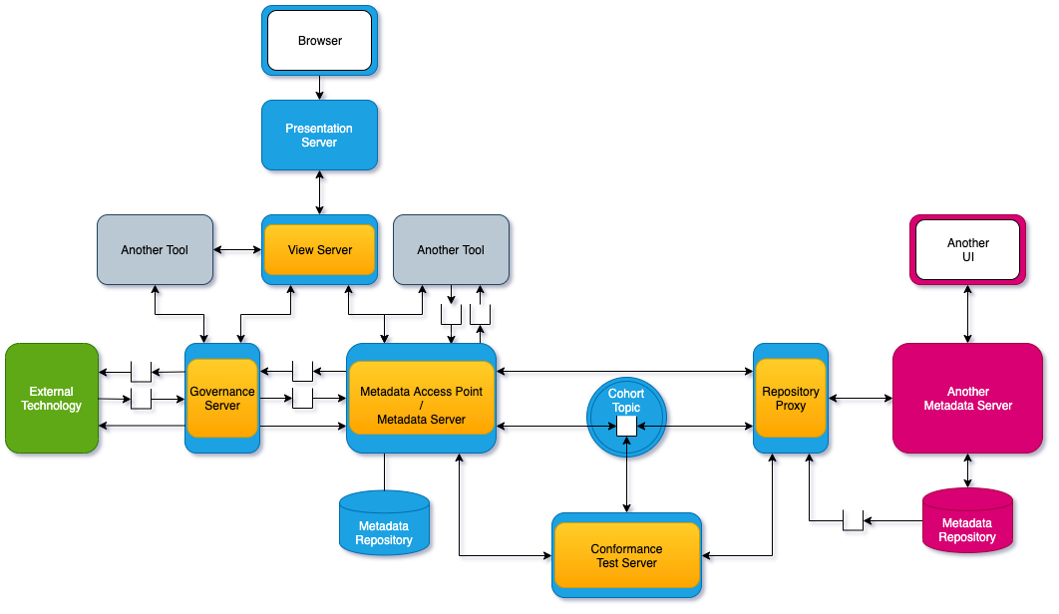
Connected OMAG Servers

Slide 25
Linkage is like onion rings
Governance Solution
Integrated Governance
Integrated Metadata

Slide 26
Configuring Servers and Platforms

Slide 27
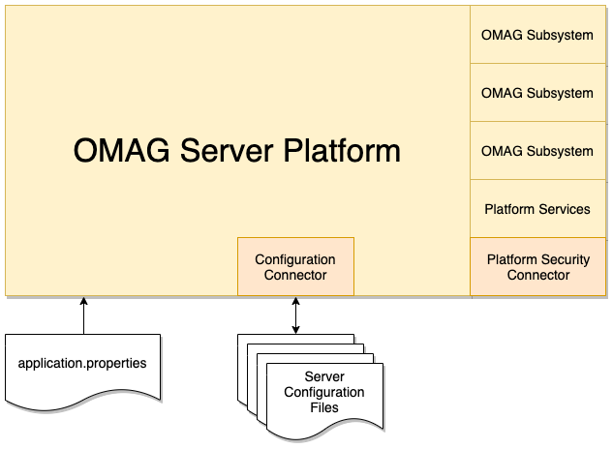
Configurability of OMAG Server Platform

Slide 28
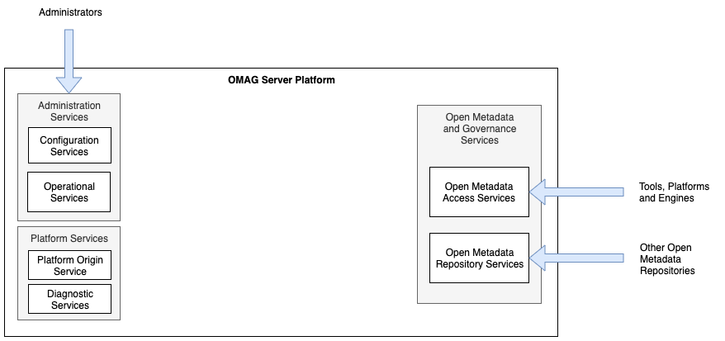
OMAG Server Platform – just started

Slide 29
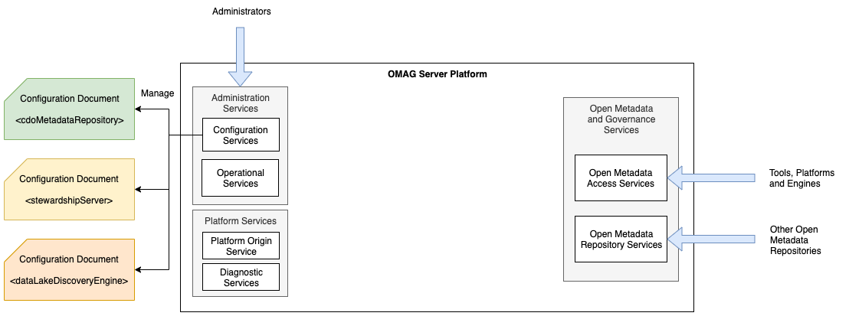
OMAG Server Platform – configuring servers

Slide 30
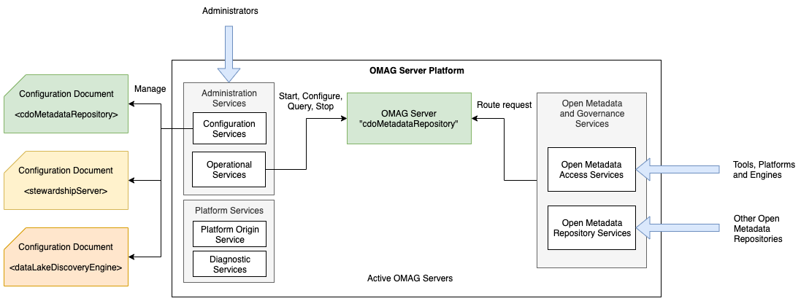
OMAG Server Platform – starting a server

Slide 31
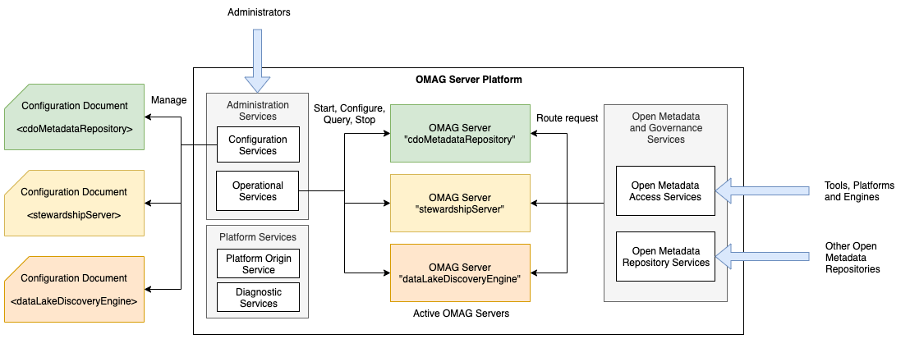
OMAG Server Platform – three servers operational

Slide 32
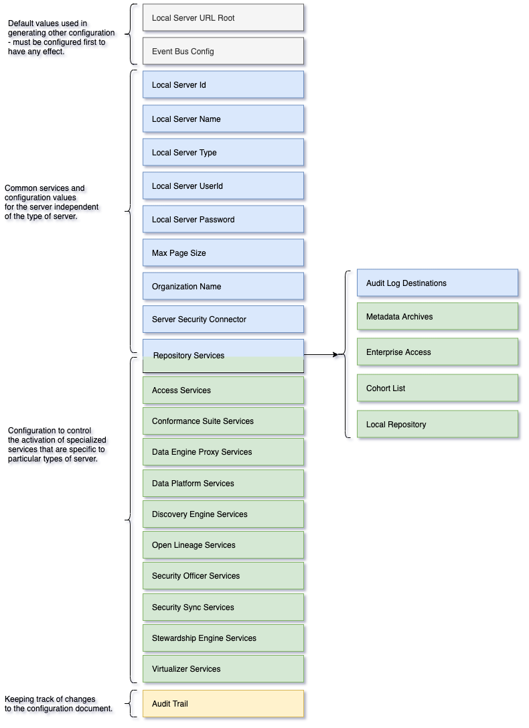
Server Configuration Document
The configuration document defines the subsystems (services) that should be activated for a specific OMAG Server.
By default configuration documents are each stored in a file called:
omag.server.{serverName}.config

Slide 33
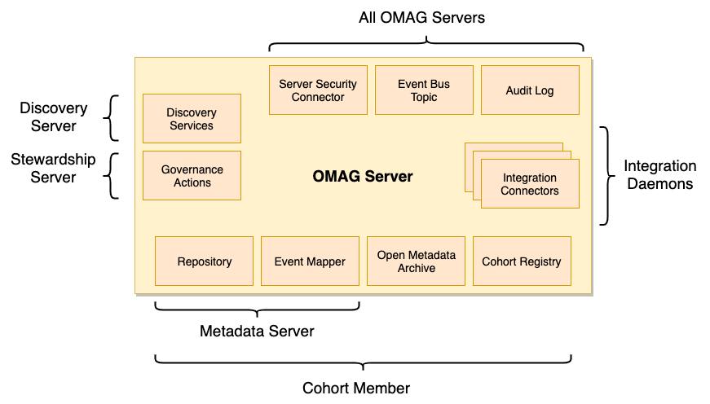
OMAG Server Connectors

Slide 34
The structure of the Connection for a connector
{
"class": "Connection",
"connectorType": {
"class": "ConnectorType",
"connectorProviderClassName": ”org.….FileBasedServerConfigStoreProvider"
},
"endpoint": {
"class": "Endpoint",
"address": "omag.server.{0}.config"
}
}
Connector Type
Implementation
Type
Connection
Endpoint
Location of
Managed
Resource

Slide 35
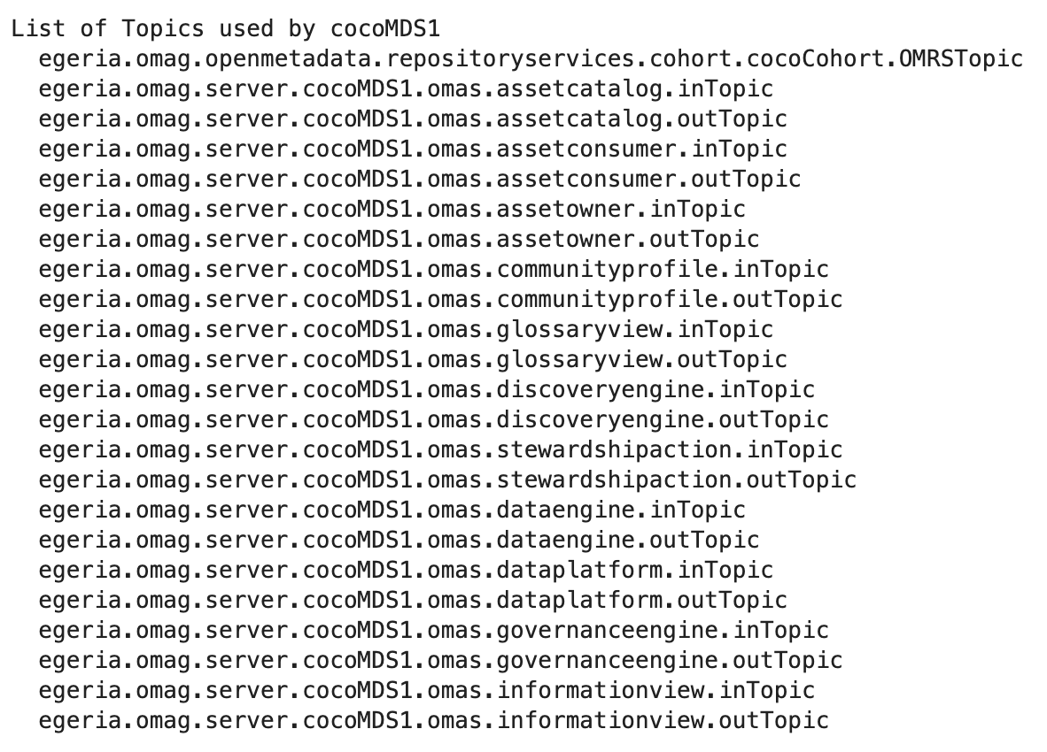
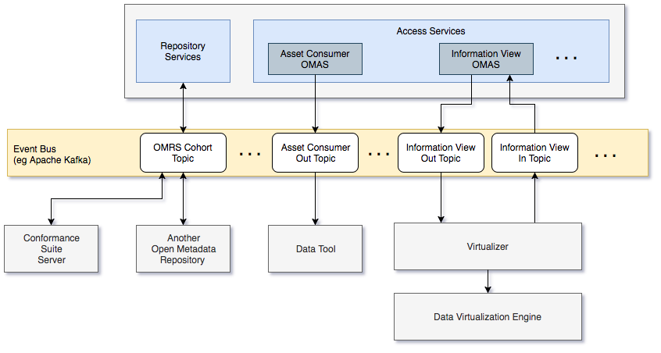
Use of the event bus connector

Slide 36
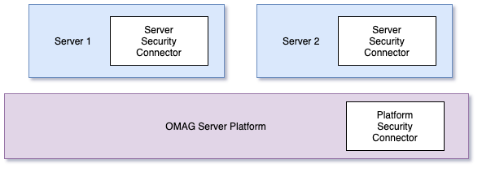
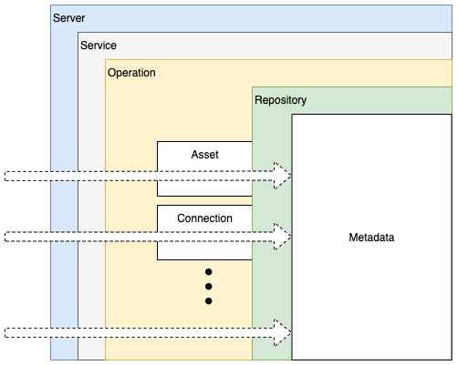
Security connectors

Slide 37
OMAG Server Startup

Slide 38
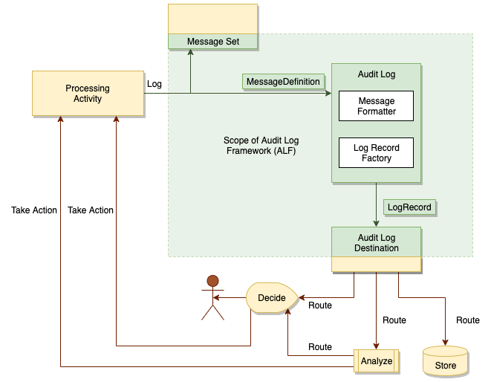
Audit Logs
Destinations
Console
SLF4J
Event Topic
File Directory

Slide 39
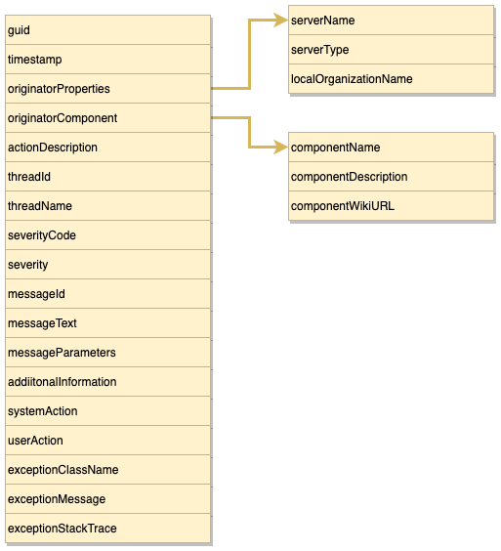
Log Record Content
Content of the log record aims to support automated processing of log records whilst also providing guidance to operations staff.

Slide 40
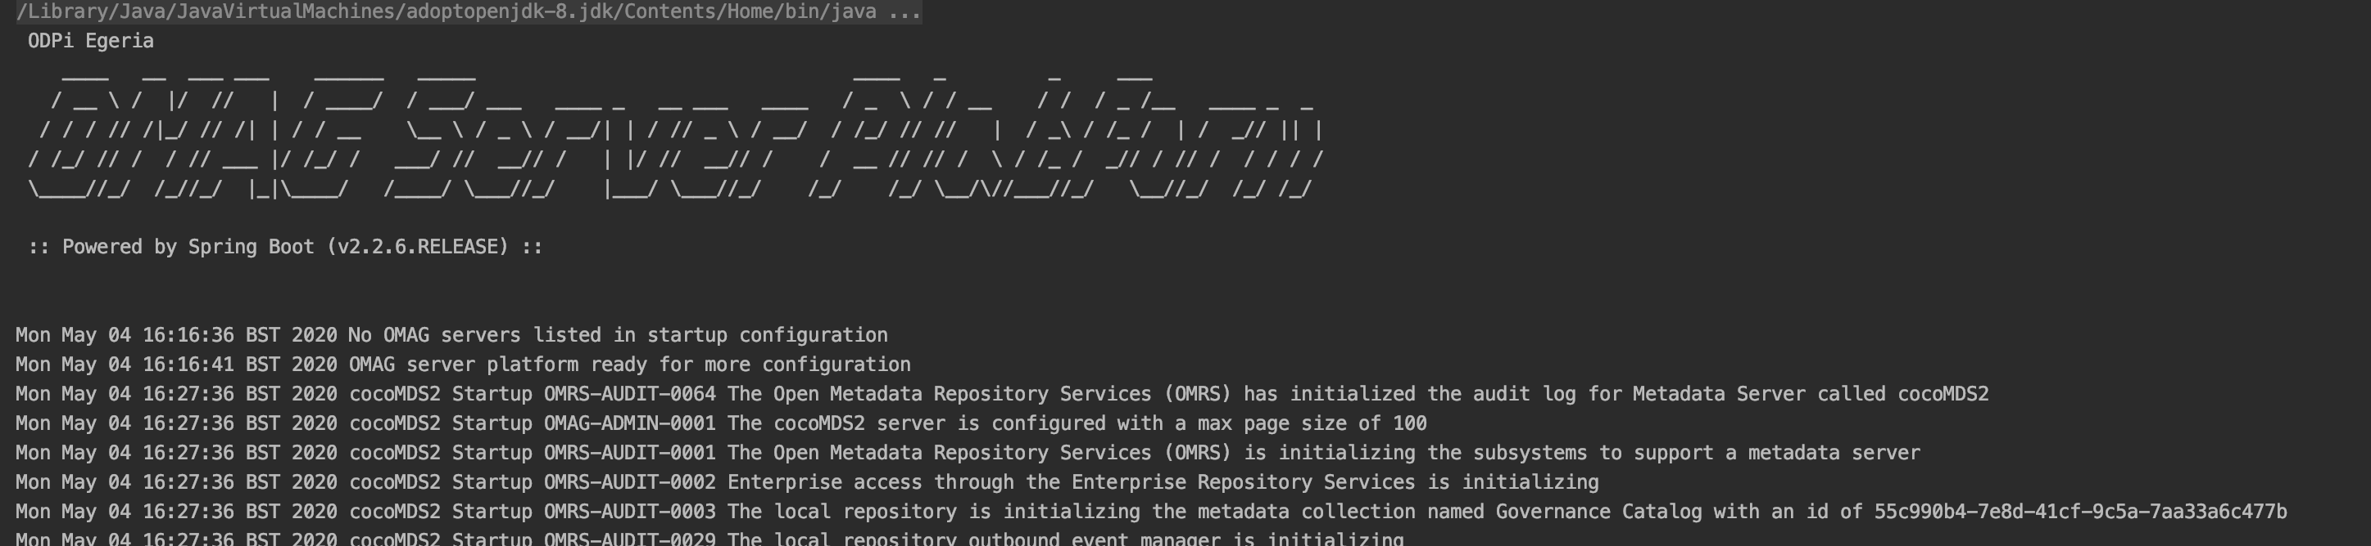
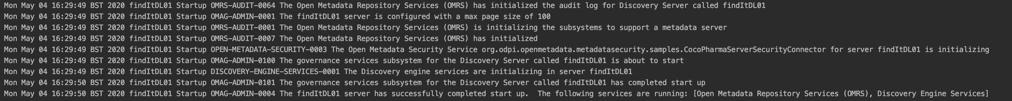
Log messages in action
Derived from Config Doc
Identity of the open metadata repository
Unique message Id

Slide 41
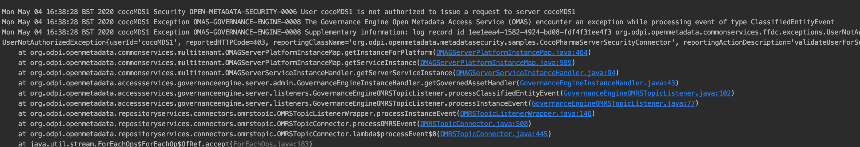
Log messages in action
Severity
Stack trace provided with exceptions

Slide 42
Customizing Egeria

Slide 43
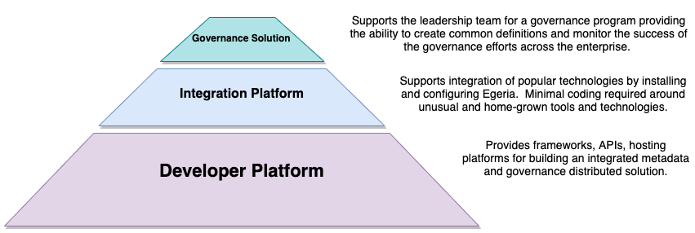
Another way to understand the Egeria capability

Slide 44
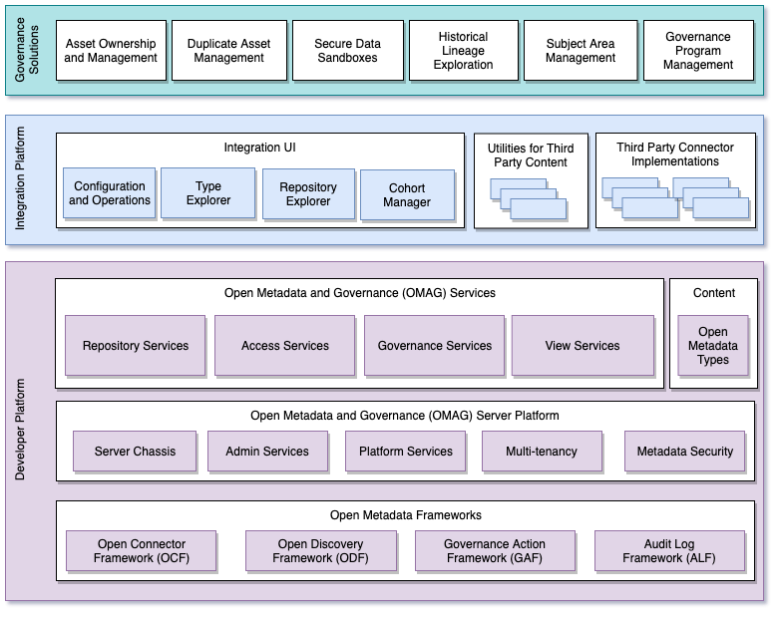
Egeria project structure
Egeria has a modular structure designed for vendors to extend with their value add.
The integration platform and governance solutions exploit the value of the enterprise view provided by the OMAG Services.

Slide 45
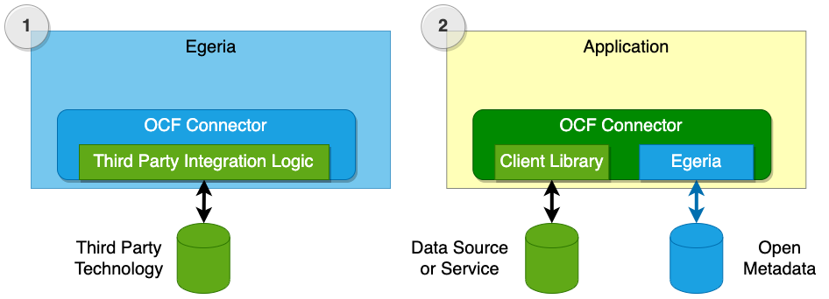
Connectors

Slide 46
Trying Egeria Yourself

Slide 47
Taking the next step with ODPi Egeria
Website https://egeria.odpi.org
Links to guides, glossary, history, design docs, …
Kubernetes/Docker deployment
Hands on labs
Coding samples
Guidance on Governance

Slide 48
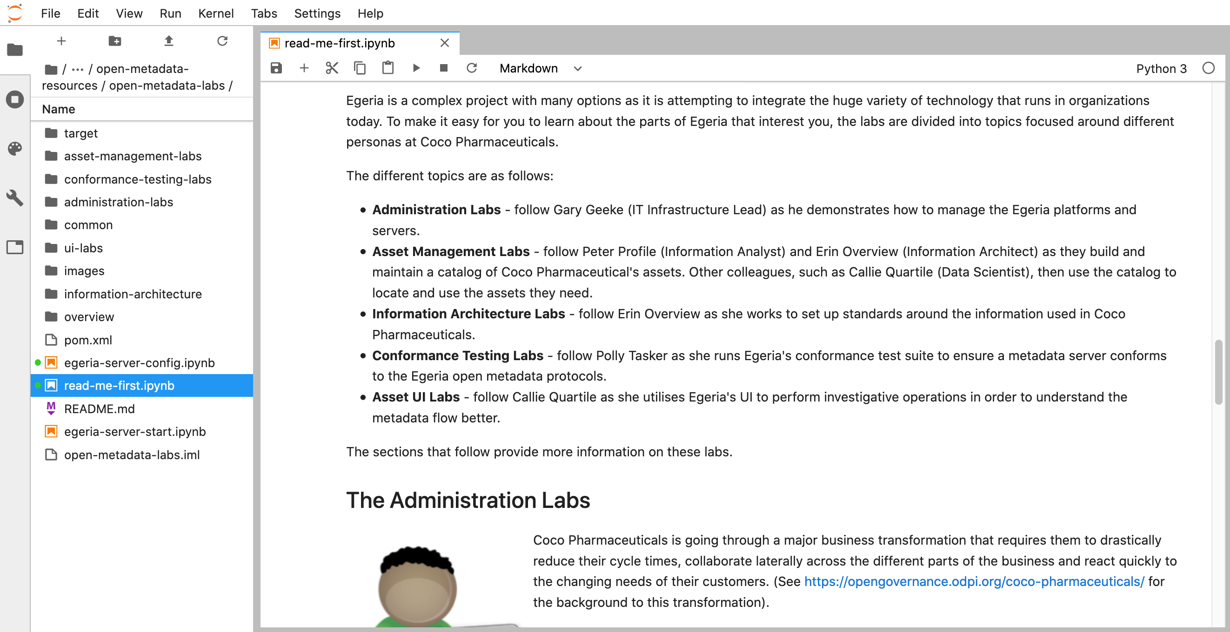
Egeria hands on labs
The Administration Labs provide an opportunity to try many of the administration and operations commands.

Slide 49
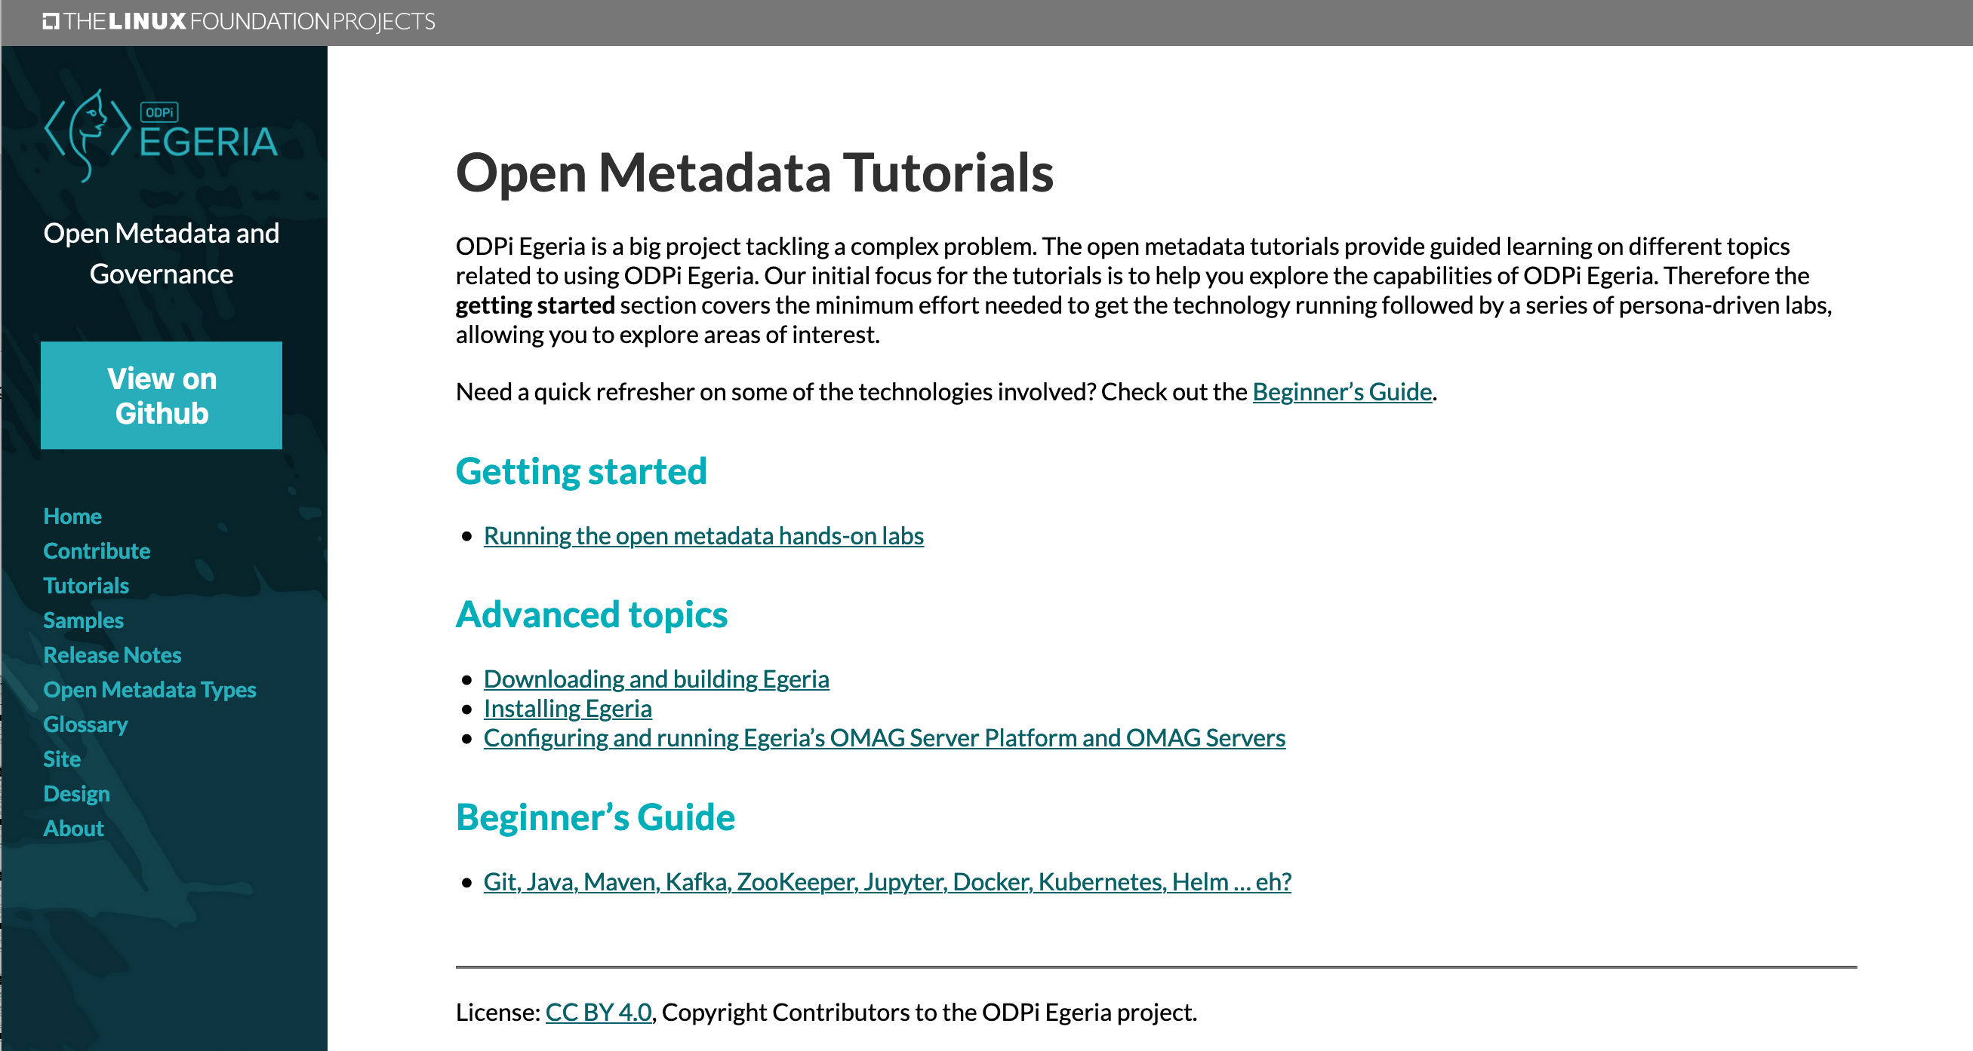
Egeria Tutorials

Slide 50
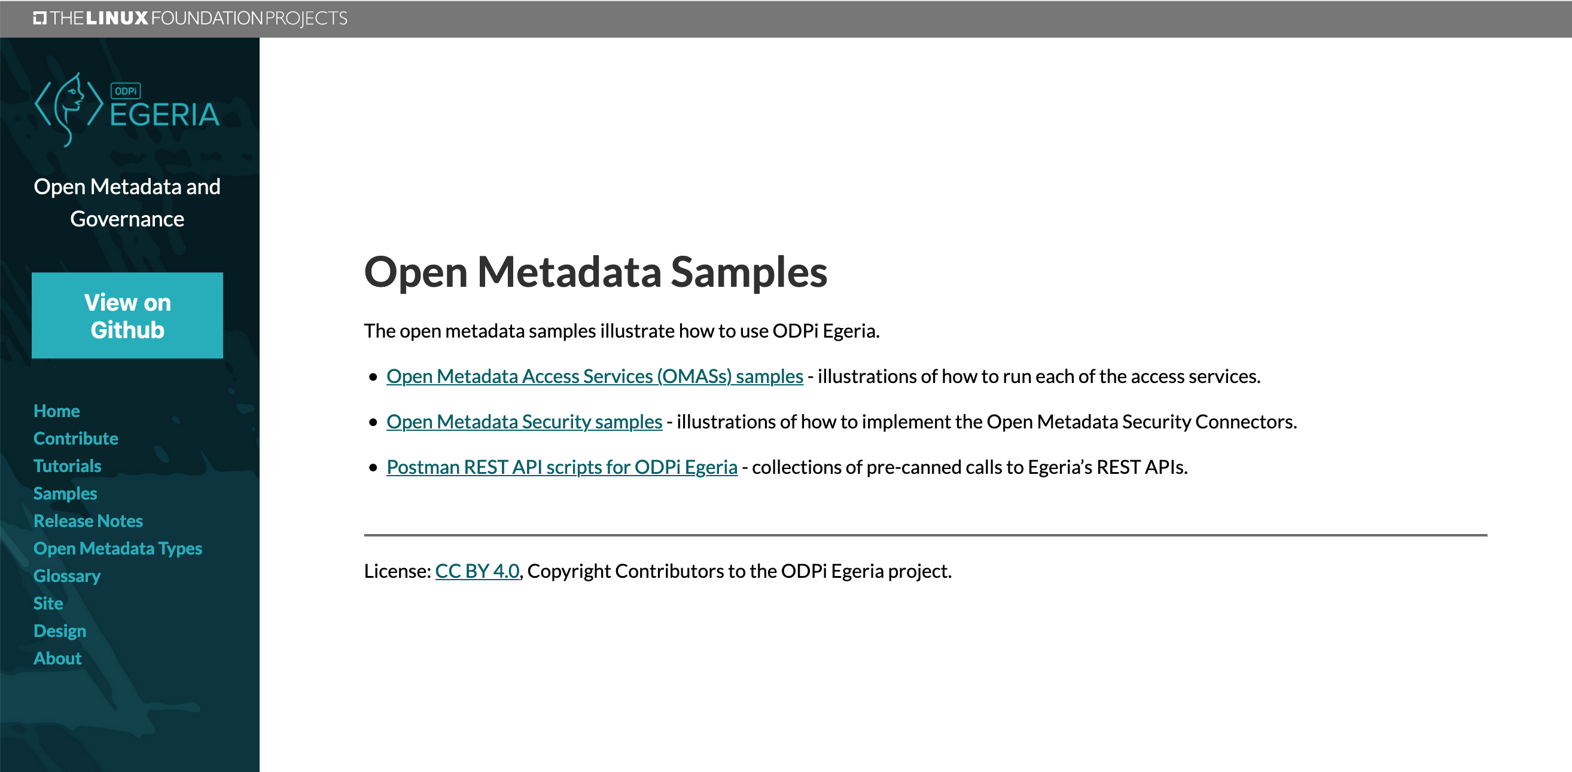
Egeria Samples

Slide 51
Open forum
z
z
z
z
z
z
z
Questions?

Slide 52
Links
Press Release and Podcast
Open source repositories
https://www.linuxfoundation.org/press-release/2018/08/odpi-announces-egeria-for-open-sharing-exchange-and-governance-of-metadata/
https://roaringelephant.org/2018/09/25/episode-107-open-metadata-and-governance-masterclass-with-mandy-chessell-part-1/
https://roaringelephant.org/2018/10/09/episode-109-open-metadata-and-governance-
masterclass-with-mandy-chessell-part-2/
https://github.com/odpi/data-governance
https://github.com/odpi/egeria

Slide 53
